Slide 1


BC’s Collaborative Digital Repository

Slide 2
Why build a collaborative digital repository?
Universal need for digital repositories:
  Comply with federal grant-funding policies
  Manage institutional digital resources
  Make digital assets discoverable
Challenges with stand alone implementation for small/medium-sized sites:
  Slow-growing collections
  Limited staff resources and technical expertise
Government interested in finding opportunities for shared services
Notes:
All post-secondaries have this need, but many sites cannot implement a repository single-handedly.

Slide 3




“develop, promote and maintain system-wide mechanisms that allow post-secondary libraries to meet the expanding information needs of the province's learners, educators, and researchers at the lowest possible cost.”
http://eln.bc.ca

Slide 4
How was Arca built?
Step 1: Strategic vision
Step 2: Needs Assessment
Step 3: Governance
Step 4: Funding
Step 5: Software Selection
Step 6: Implementation
Step 7: Early Adopters & Recruitment
Step 8: Sustainability
BC ELN Arca Project page: http://bceln.ca/services/shared-services/arca

Slide 5


Why choose Islandora?
Multi-site implementation - 1 repository, many interfaces
Canadian vendor-supported hosting
Standards-based for interoperability with other repositories
Features for consortial management
Intuitive interface
Vendor-independent access
Open access, with possibility of permissions-based access
All types of materials, not just scholarly

Slide 6
Arca Participant Benefits & Responsibilities
Benefits:
  Coordinate digital resource management efficiently
  Reinforce institution brand position & prestige
  Comply with federal grant funding policies
  Avoid costs through centralized coordination & licensing
  Participate in governance, strategic planning, and service development
  Access the Arca Administrative Centre, including technical expertise, training, communication infrastructure, etc.
Responsibilities:
  Be a BC ELN Partner Library (for now!)
  Provide a yearly Arca Service Support fee
  Participate in development of the Arca enhancement list

Slide 7













Slide 8
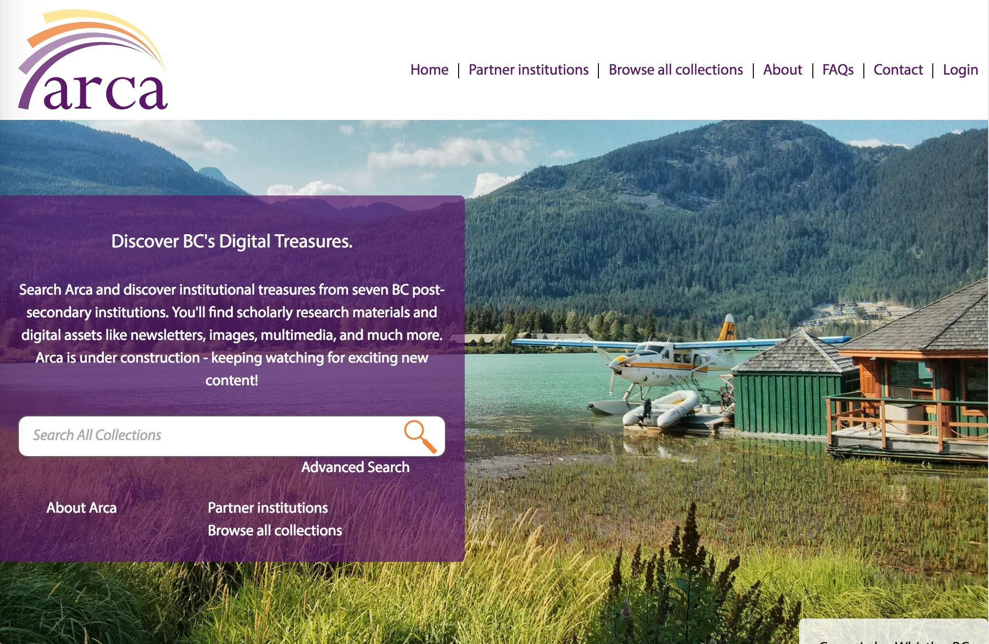
http://arcabc.ca

Slide 9
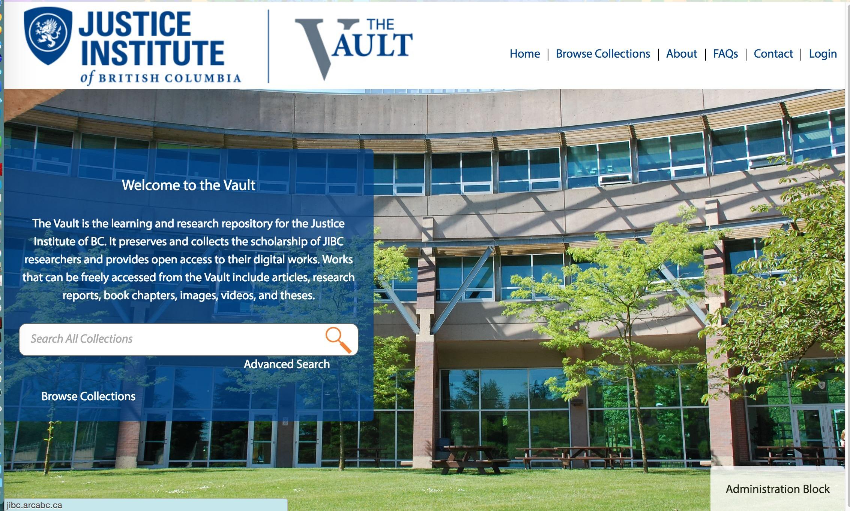
http://jibc.arcabc.ca
Notes:
Institutional branding

Slide 10

http://ufv.arcabc.ca

Slide 11
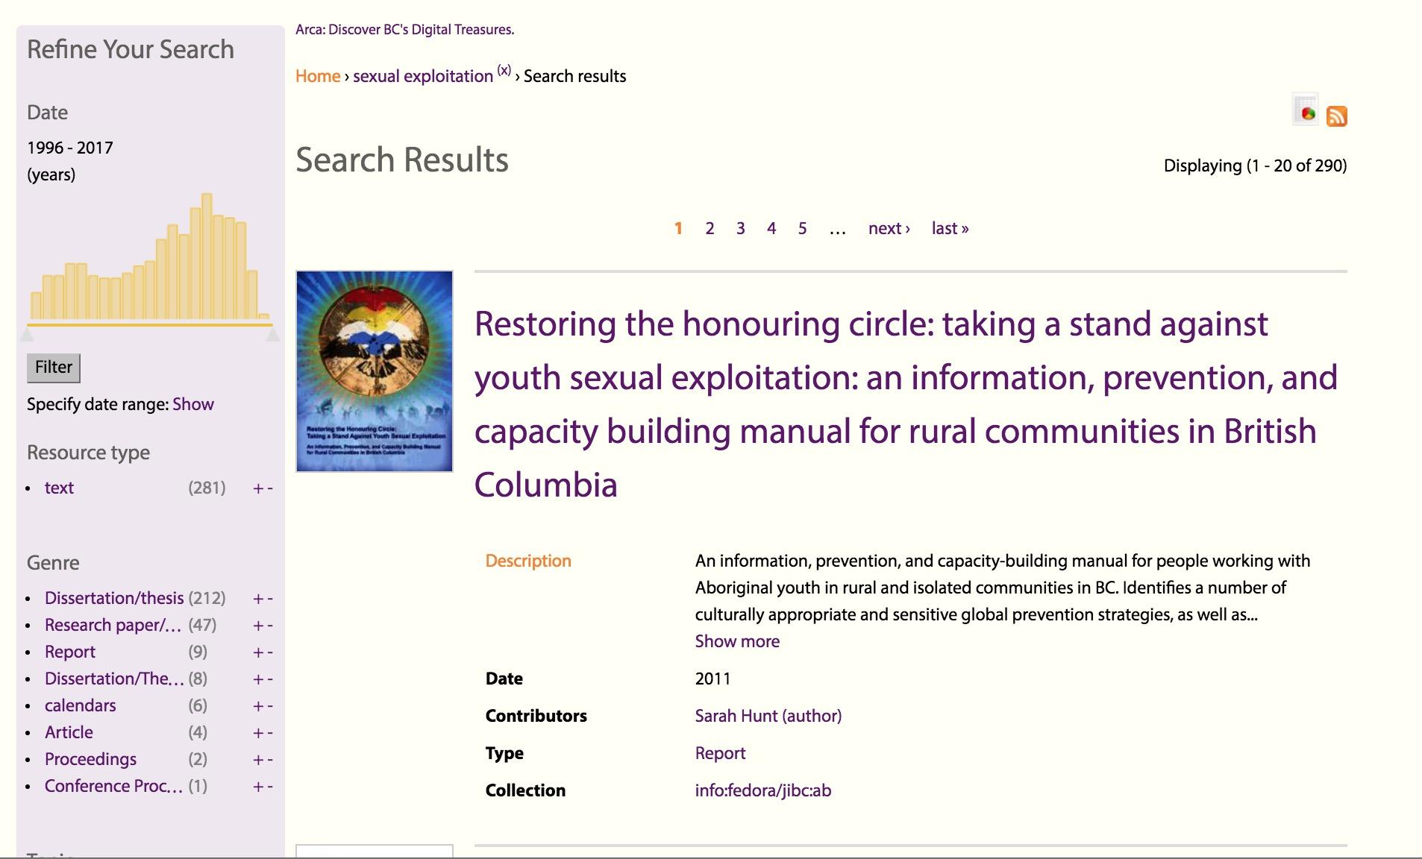
Notes:
Search results display

Slide 12
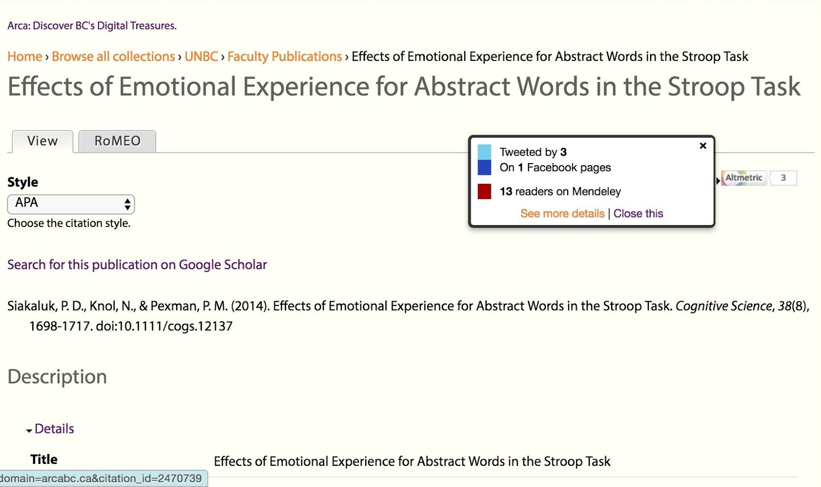
Notes:
Altmetrics badge

Slide 13
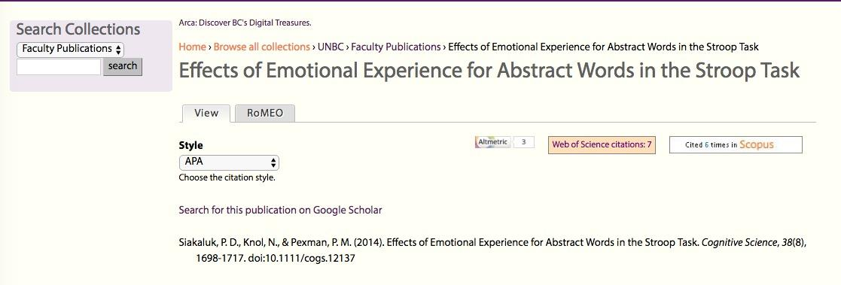
Notes:
Almetrics badge: Web of Science and Scopus
Search within Collection

Slide 14
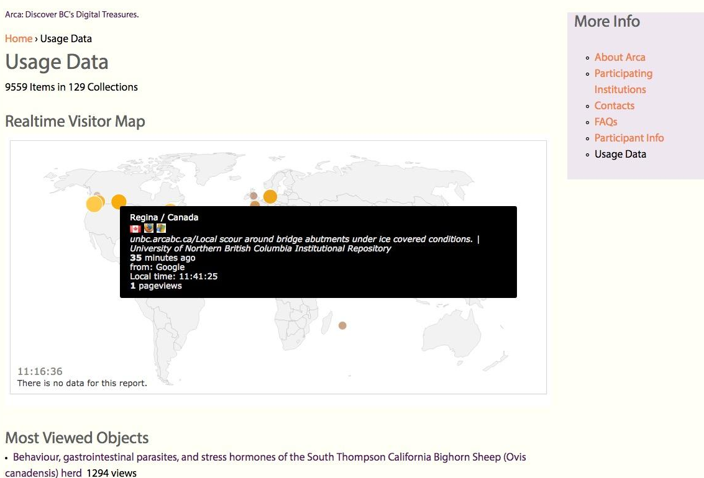
Notes:
Piwik integration
OAI-PMH available

Slide 15
Challenges & Successes
Challenges:
  Bugs and enhancements in the open source environment
    E.g. Scholar’s module enhancements
  Storage and scalability
    Privacy concerns are forefront in BC
    Canadian hosting options are limited and expensive
    Partnerships with other Canadian consortia will make this easier
Successes:
  Meeting diverse needs
  Building a community of practice in BC
    Open documentation and training
Notes:
Challenges/Successes

Slide 16
Contributing to the Community
Bug fixes/enhancements/modules etc.
Crowd-funding proposal to Islandora Foundation
Islandora Educational Support
Islandora’s first regional user group

Slide 17
Questions?
Sunni - Project Lead sunnin@eln.bc.ca / 778-782-6937
Brandon - Technical Lead brandonw@eln.bc.ca / 778-782-5419

